Slide 1
4 – Where should I look?

Slide 2
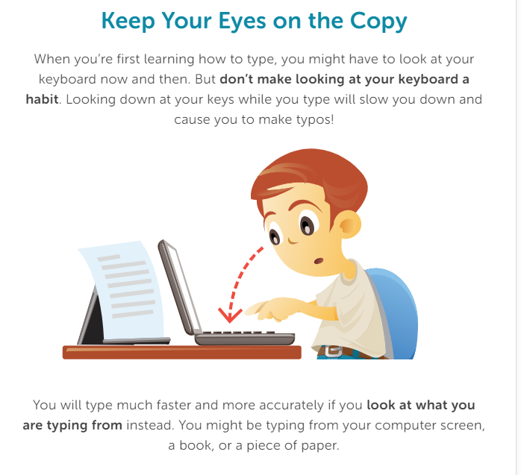

Slide 3
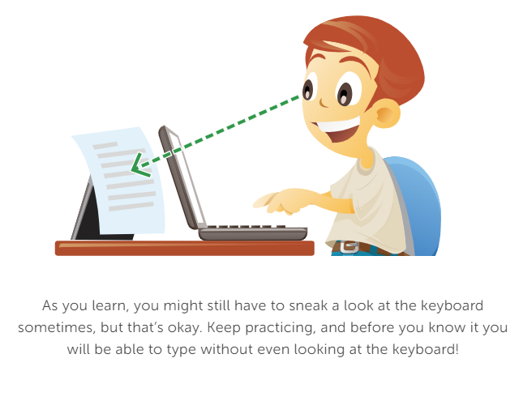

Slide 4
Complete Where Should I Look Review Packet

